Slide 1
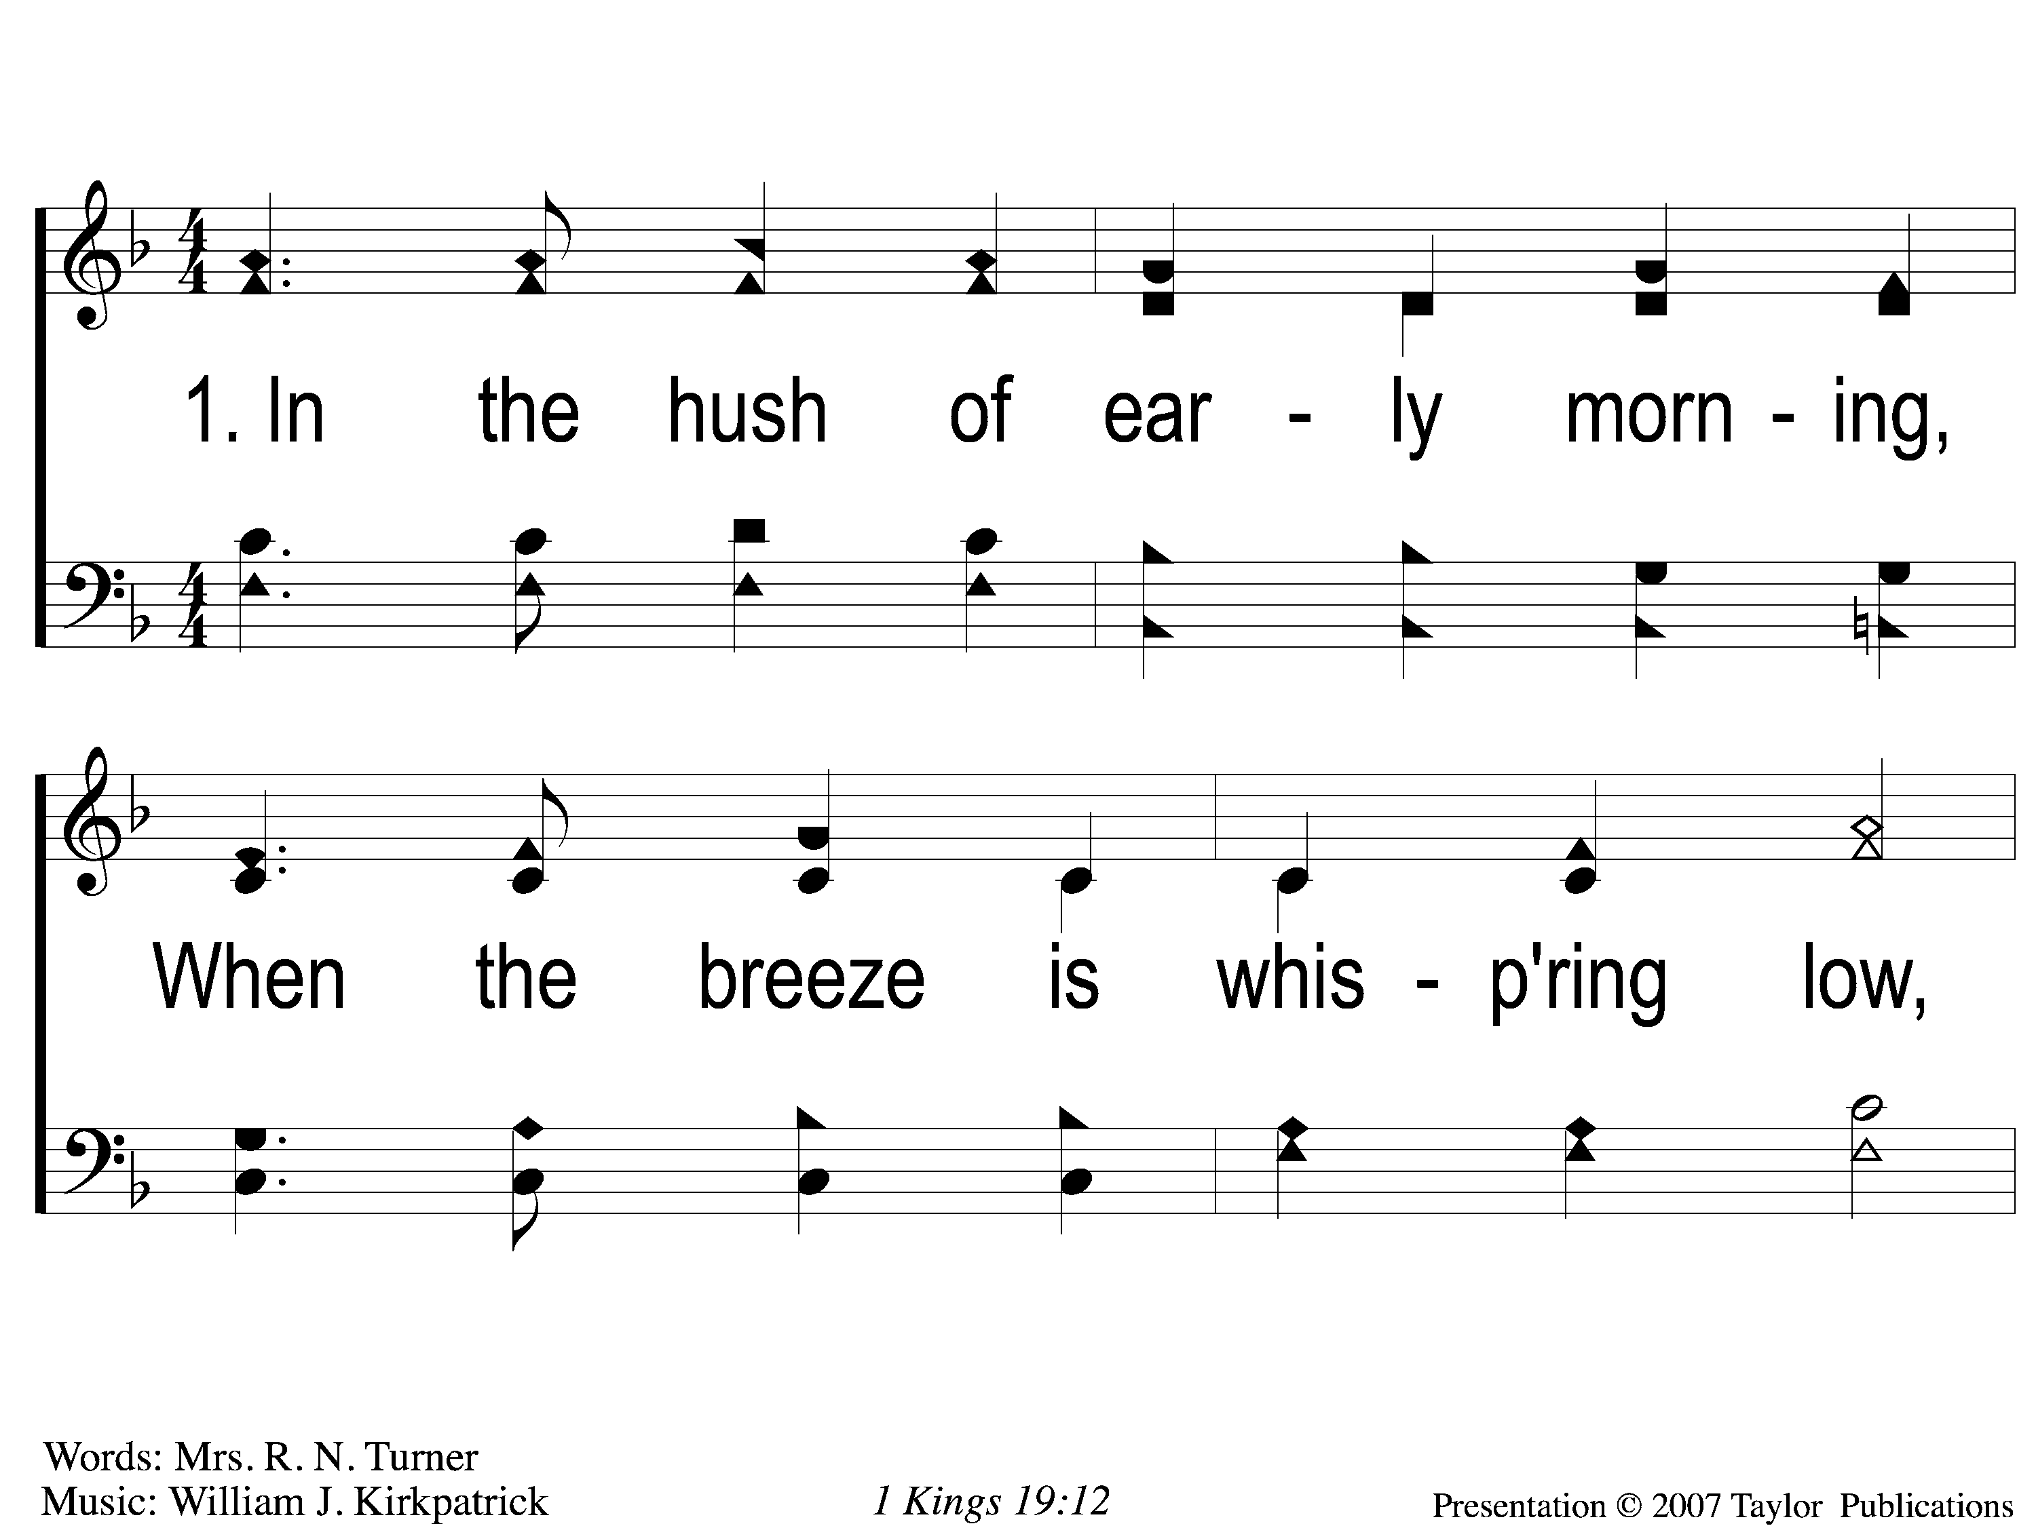
1-1 In the Hush of Early Morning
In the Hush of Early Morning
153
ePraise Hymn Presentation © 2005 Taylor Publications

Slide 2
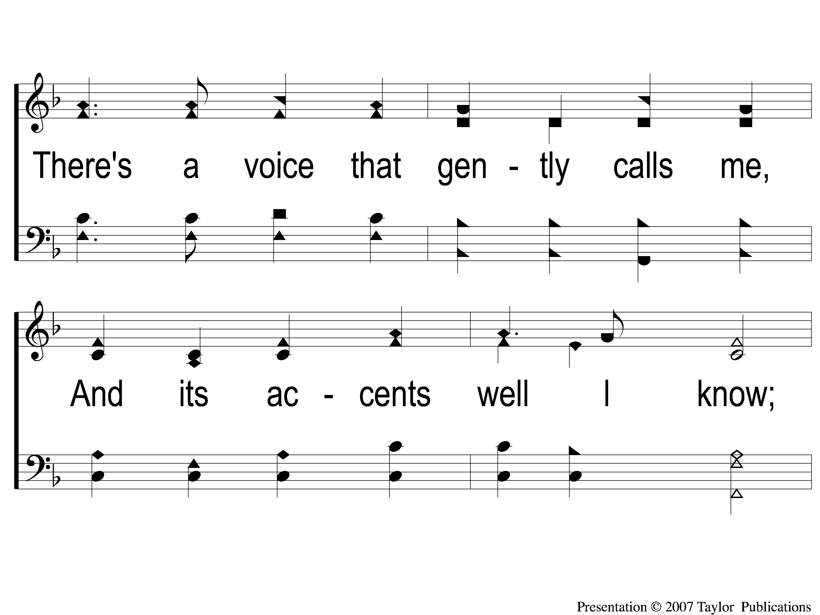
1-2 In the Hush of Early Morning
In the Hush of Early Morning
153
ePraise Hymn Presentation © 2005 Taylor Publications

Slide 3
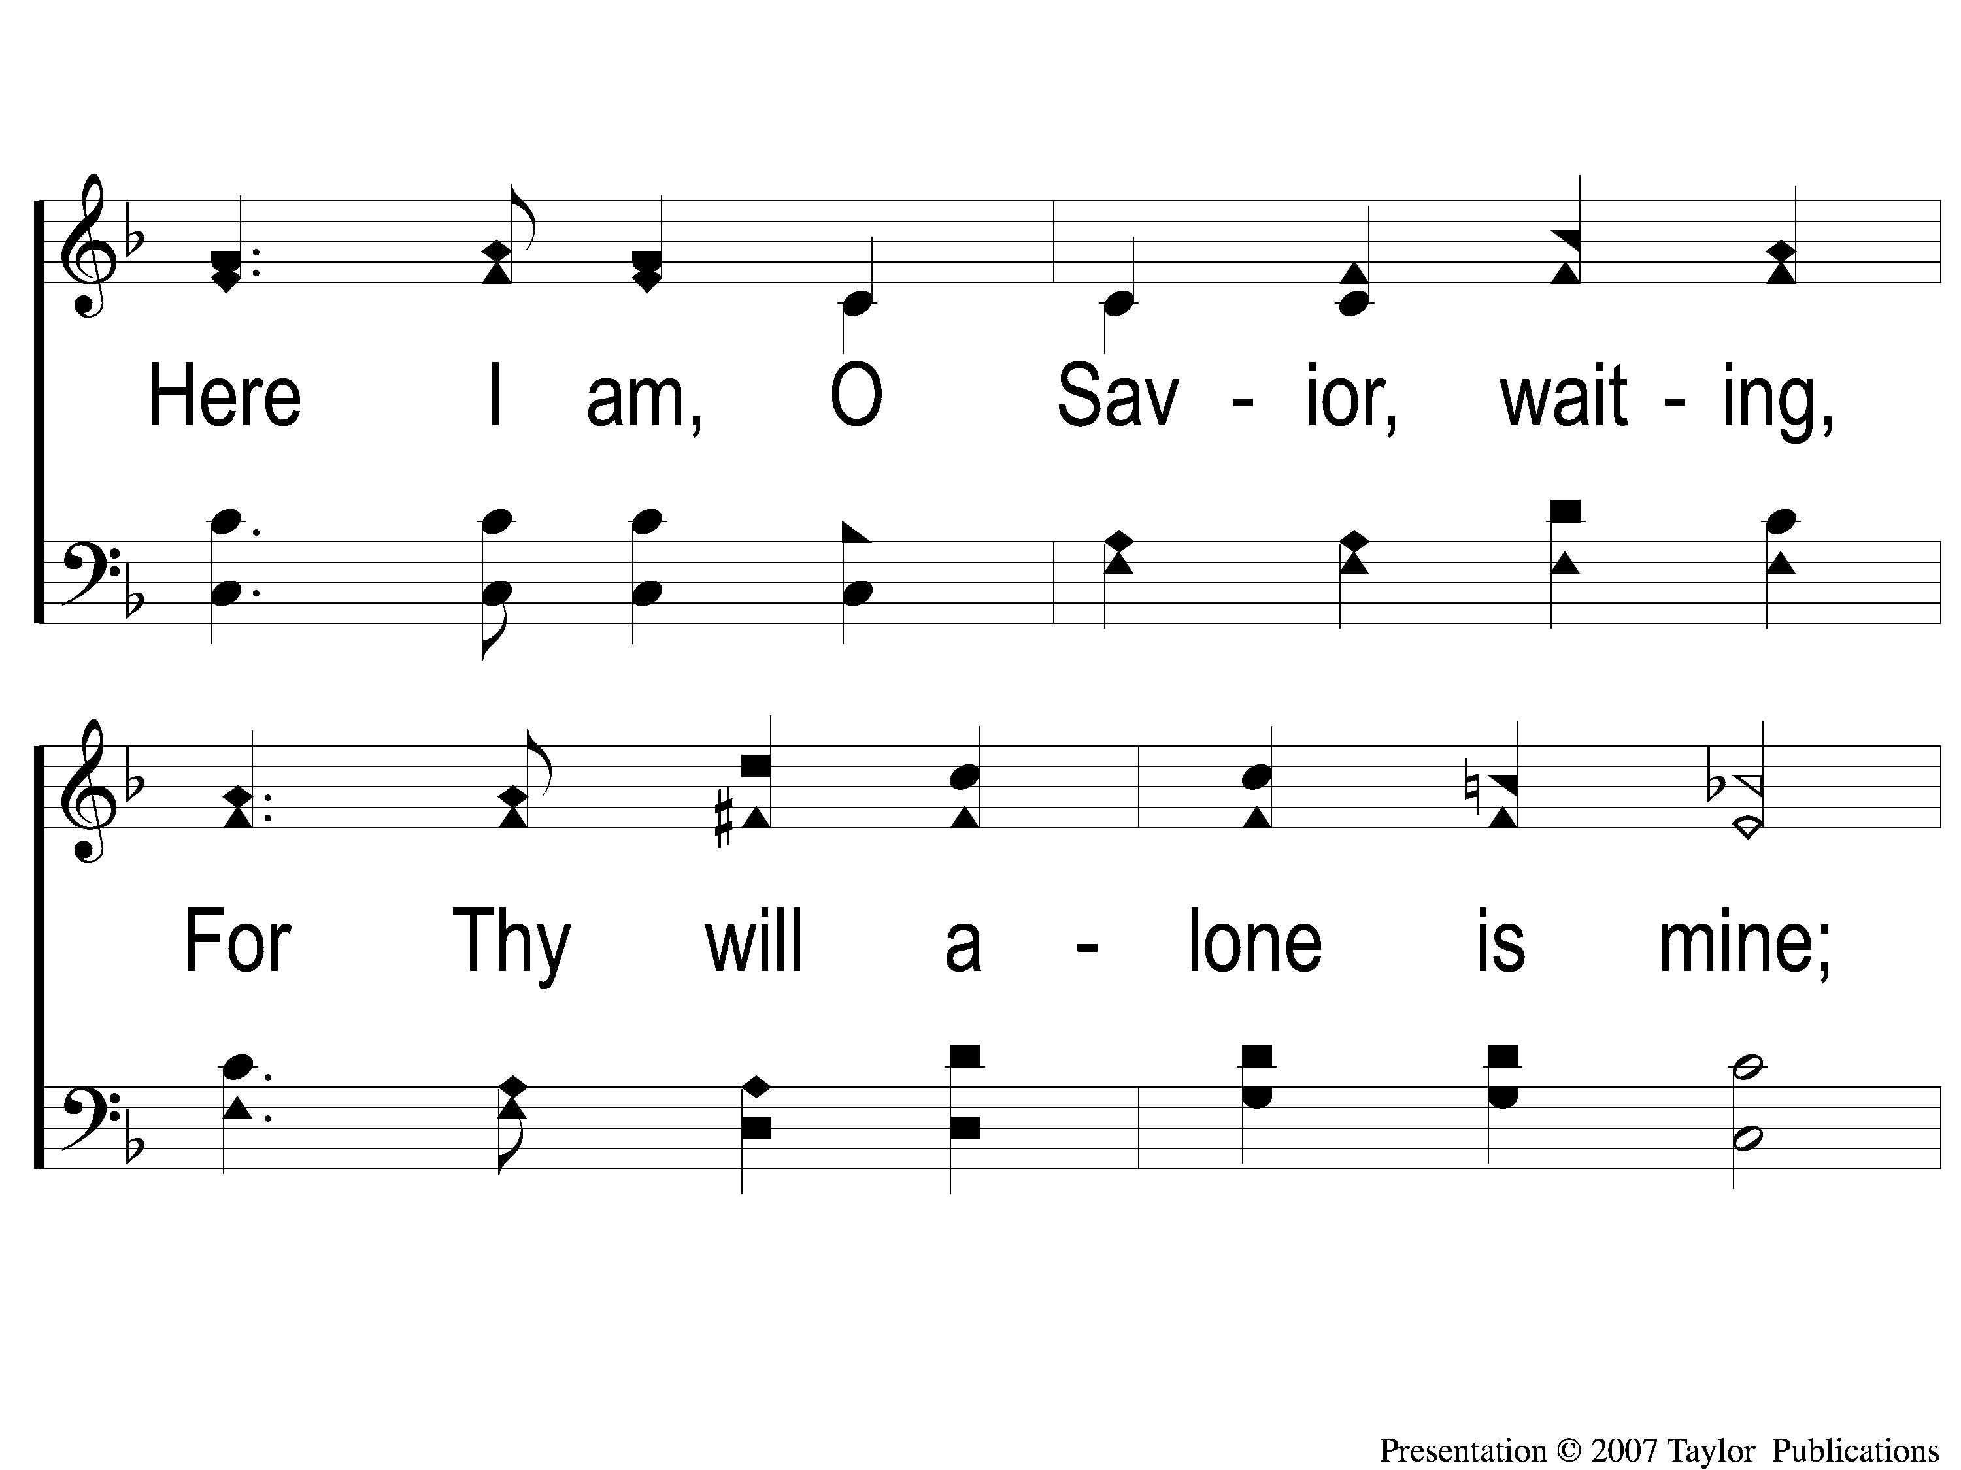
1-3 In the Hush of Early Morning
In the Hush of Early Morning
153
ePraise Hymn Presentation © 2005 Taylor Publications

Slide 4
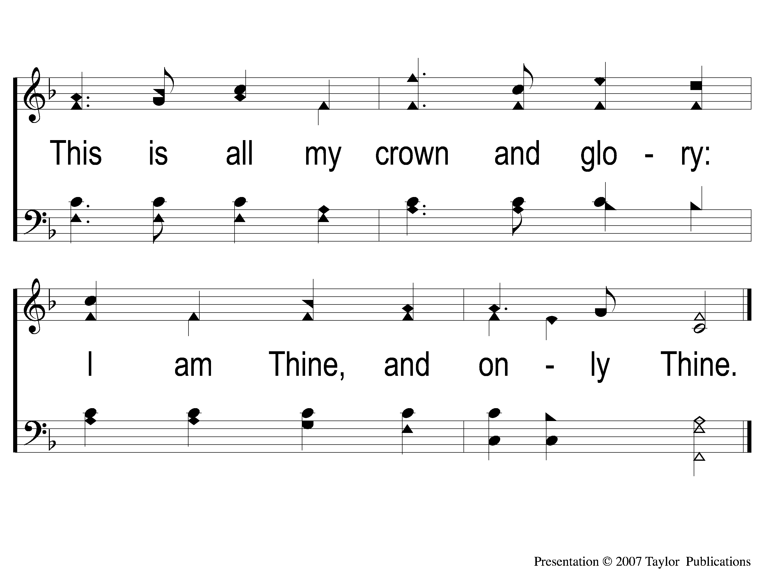
1-4 In the Hush of Early Morning
In the Hush of Early Morning
153
ePraise Hymn Presentation © 2005 Taylor Publications

Slide 5
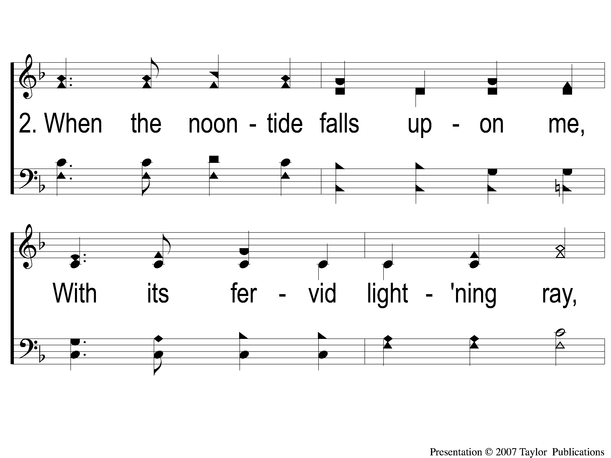
2-1 In the Hush of Early Morning
In the Hush of Early Morning
153
ePraise Hymn Presentation © 2005 Taylor Publications

Slide 6
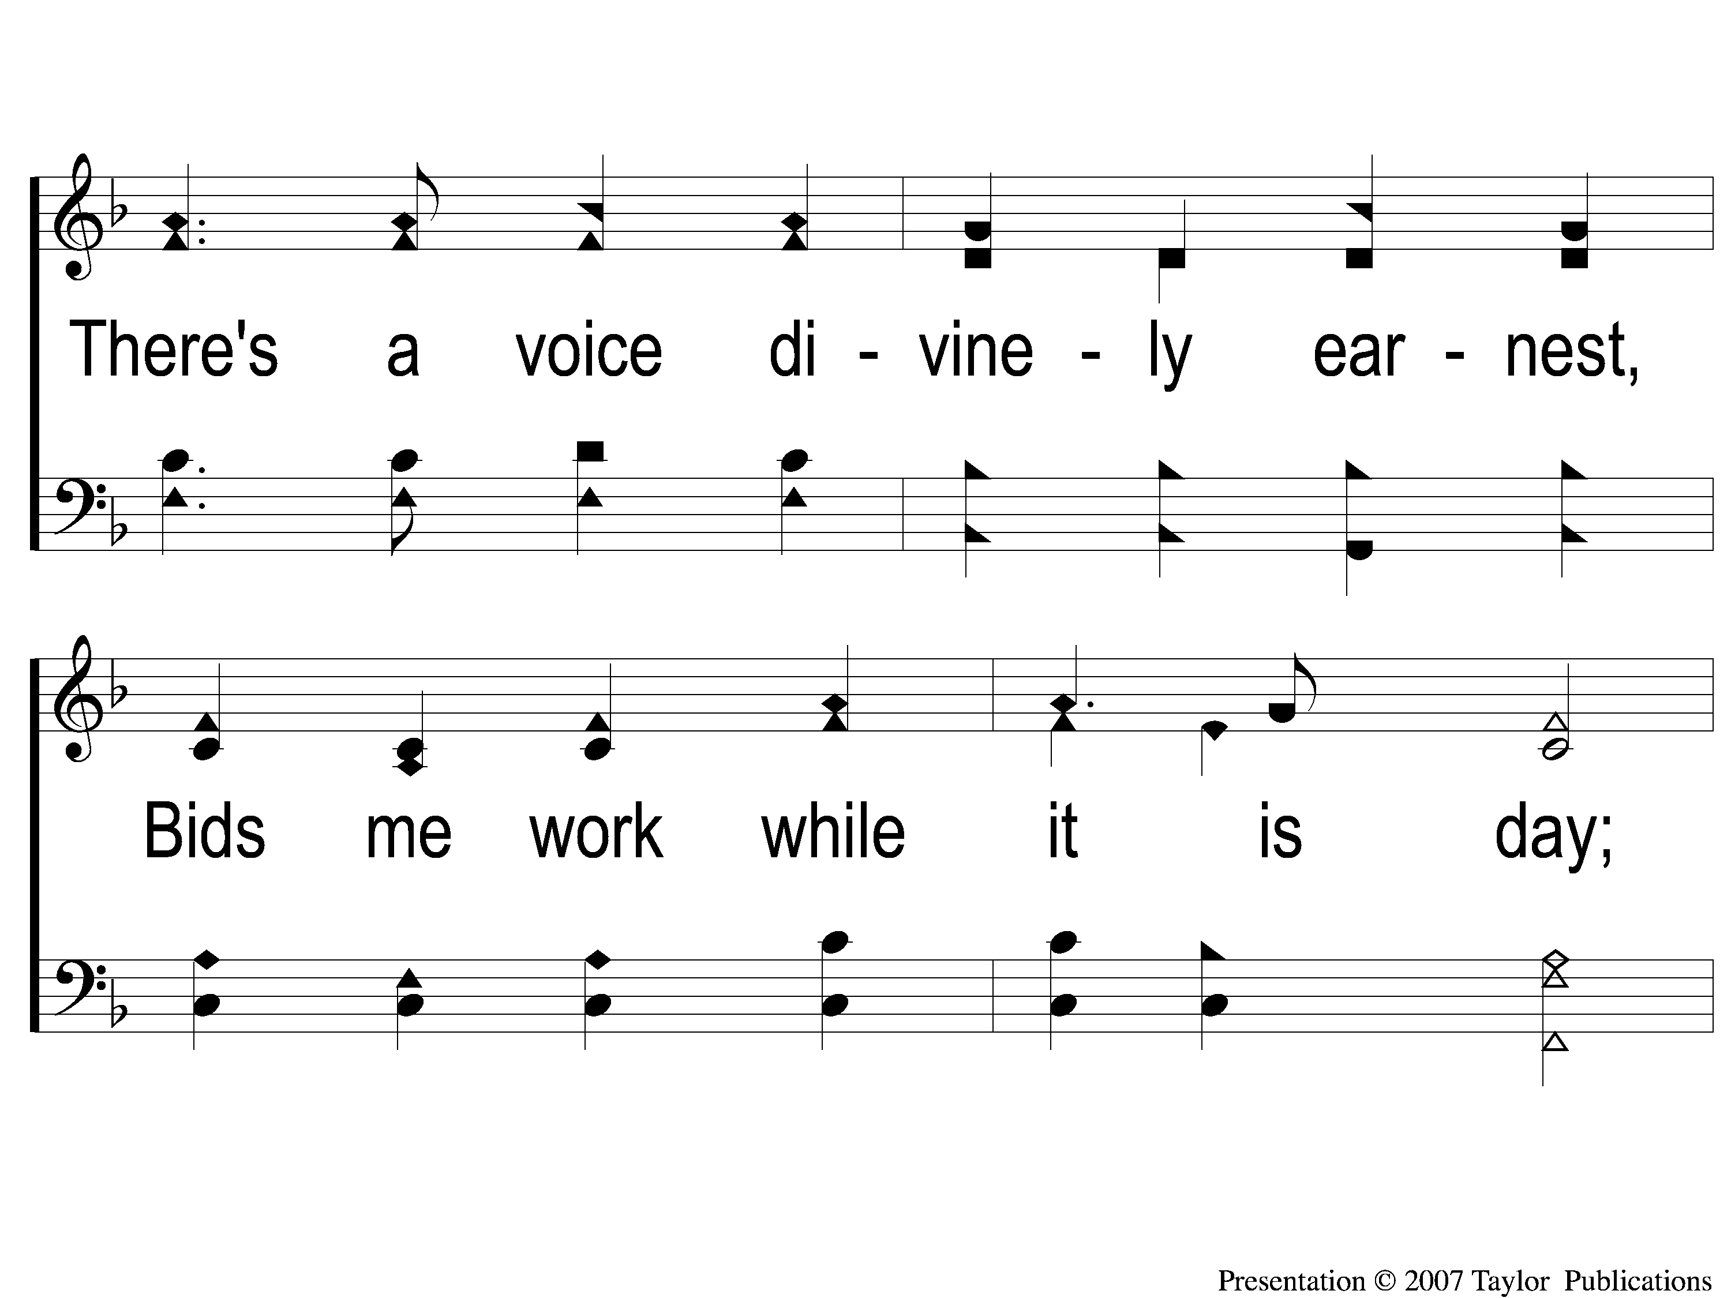
2-2 In the Hush of Early Morning
In the Hush of Early Morning
153
ePraise Hymn Presentation © 2005 Taylor Publications

Slide 7
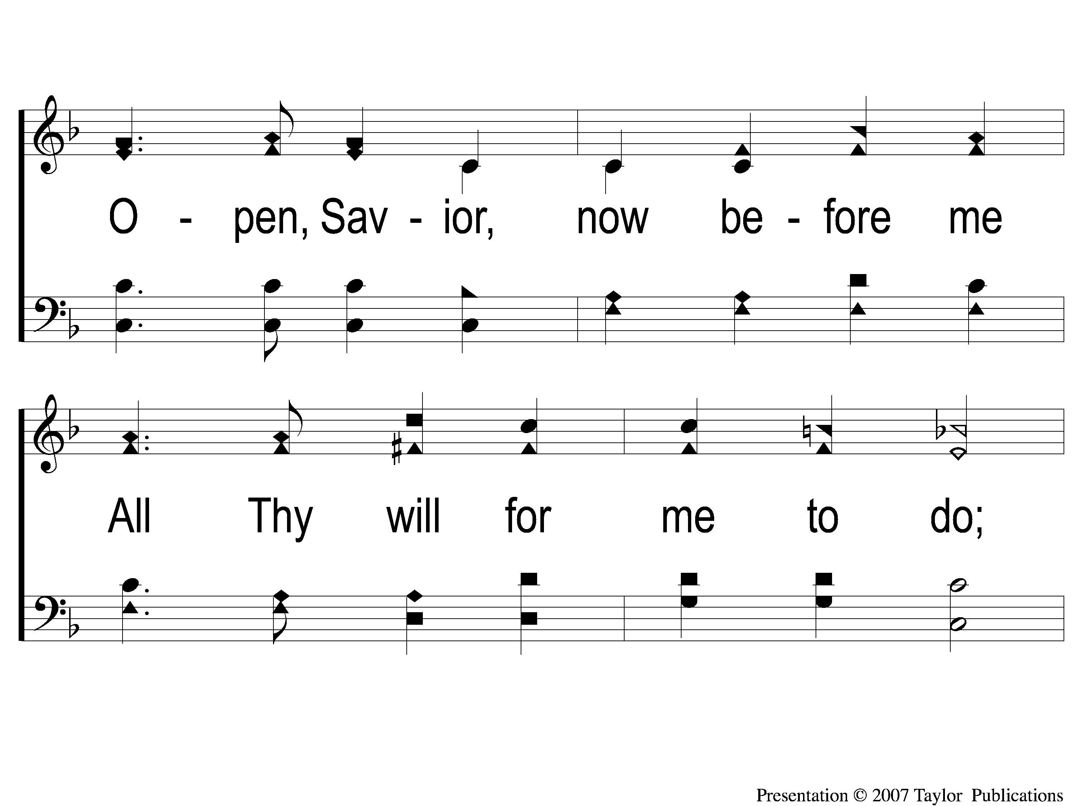
2-3 In the Hush of Early Morning
In the Hush of Early Morning
153
ePraise Hymn Presentation © 2005 Taylor Publications

Slide 8
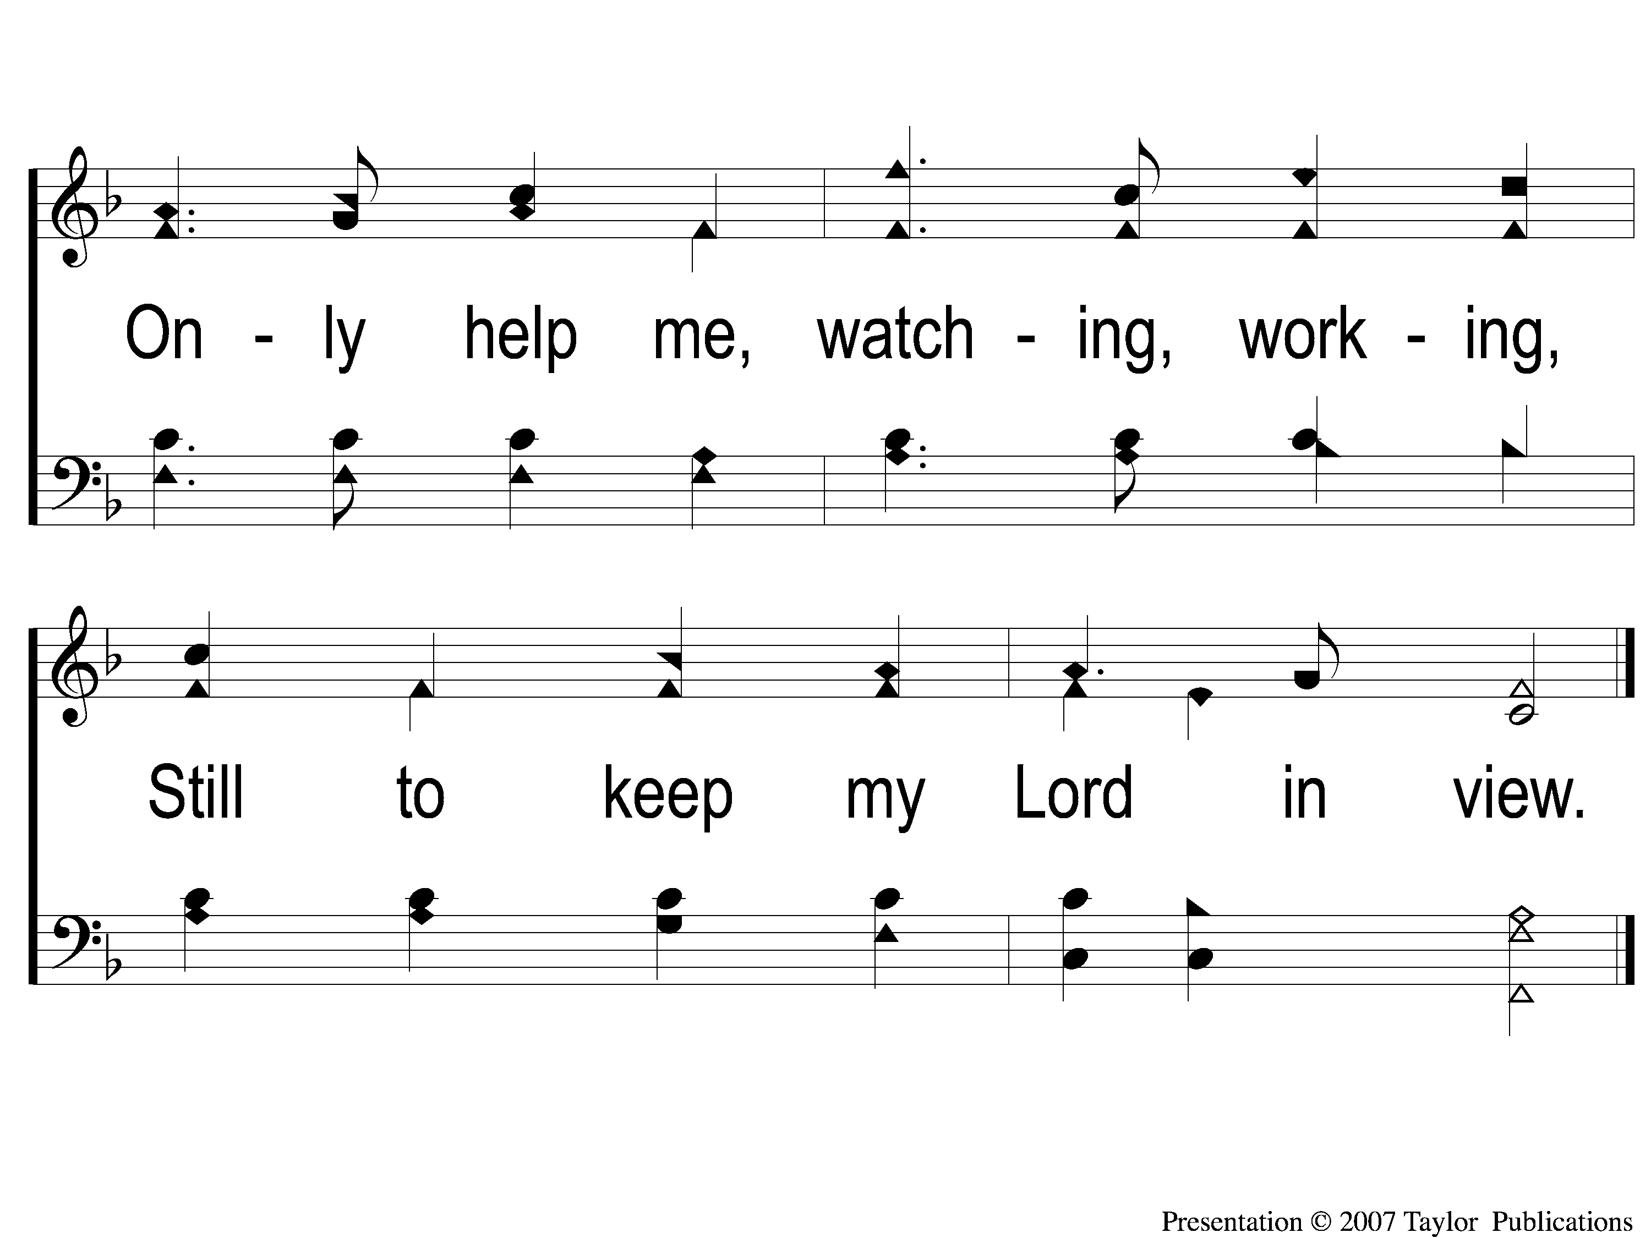
2-4 In the Hush of Early Morning
In the Hush of Early Morning
153
ePraise Hymn Presentation © 2005 Taylor Publications

Slide 9
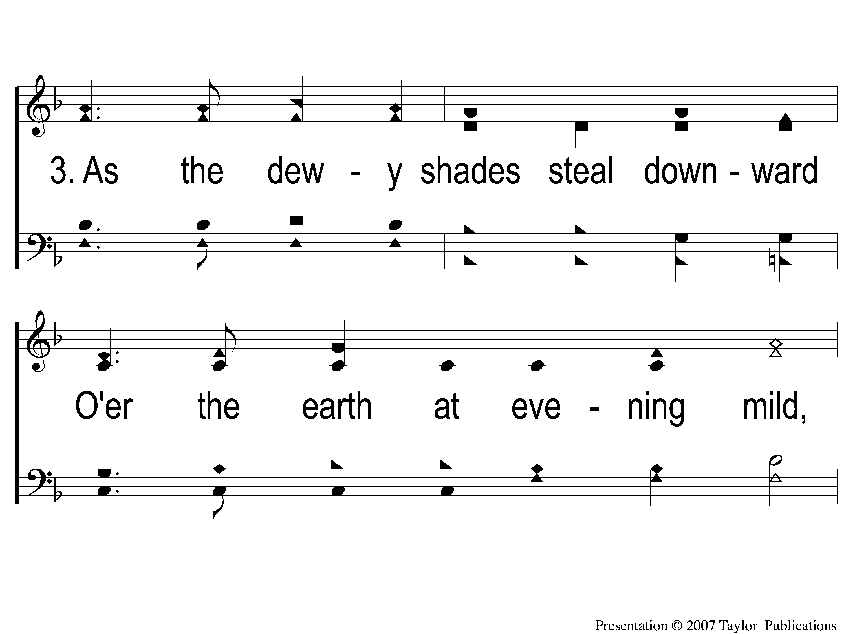
3-1 In the Hush of Early Morning
In the Hush of Early Morning
153
ePraise Hymn Presentation © 2005 Taylor Publications

Slide 10
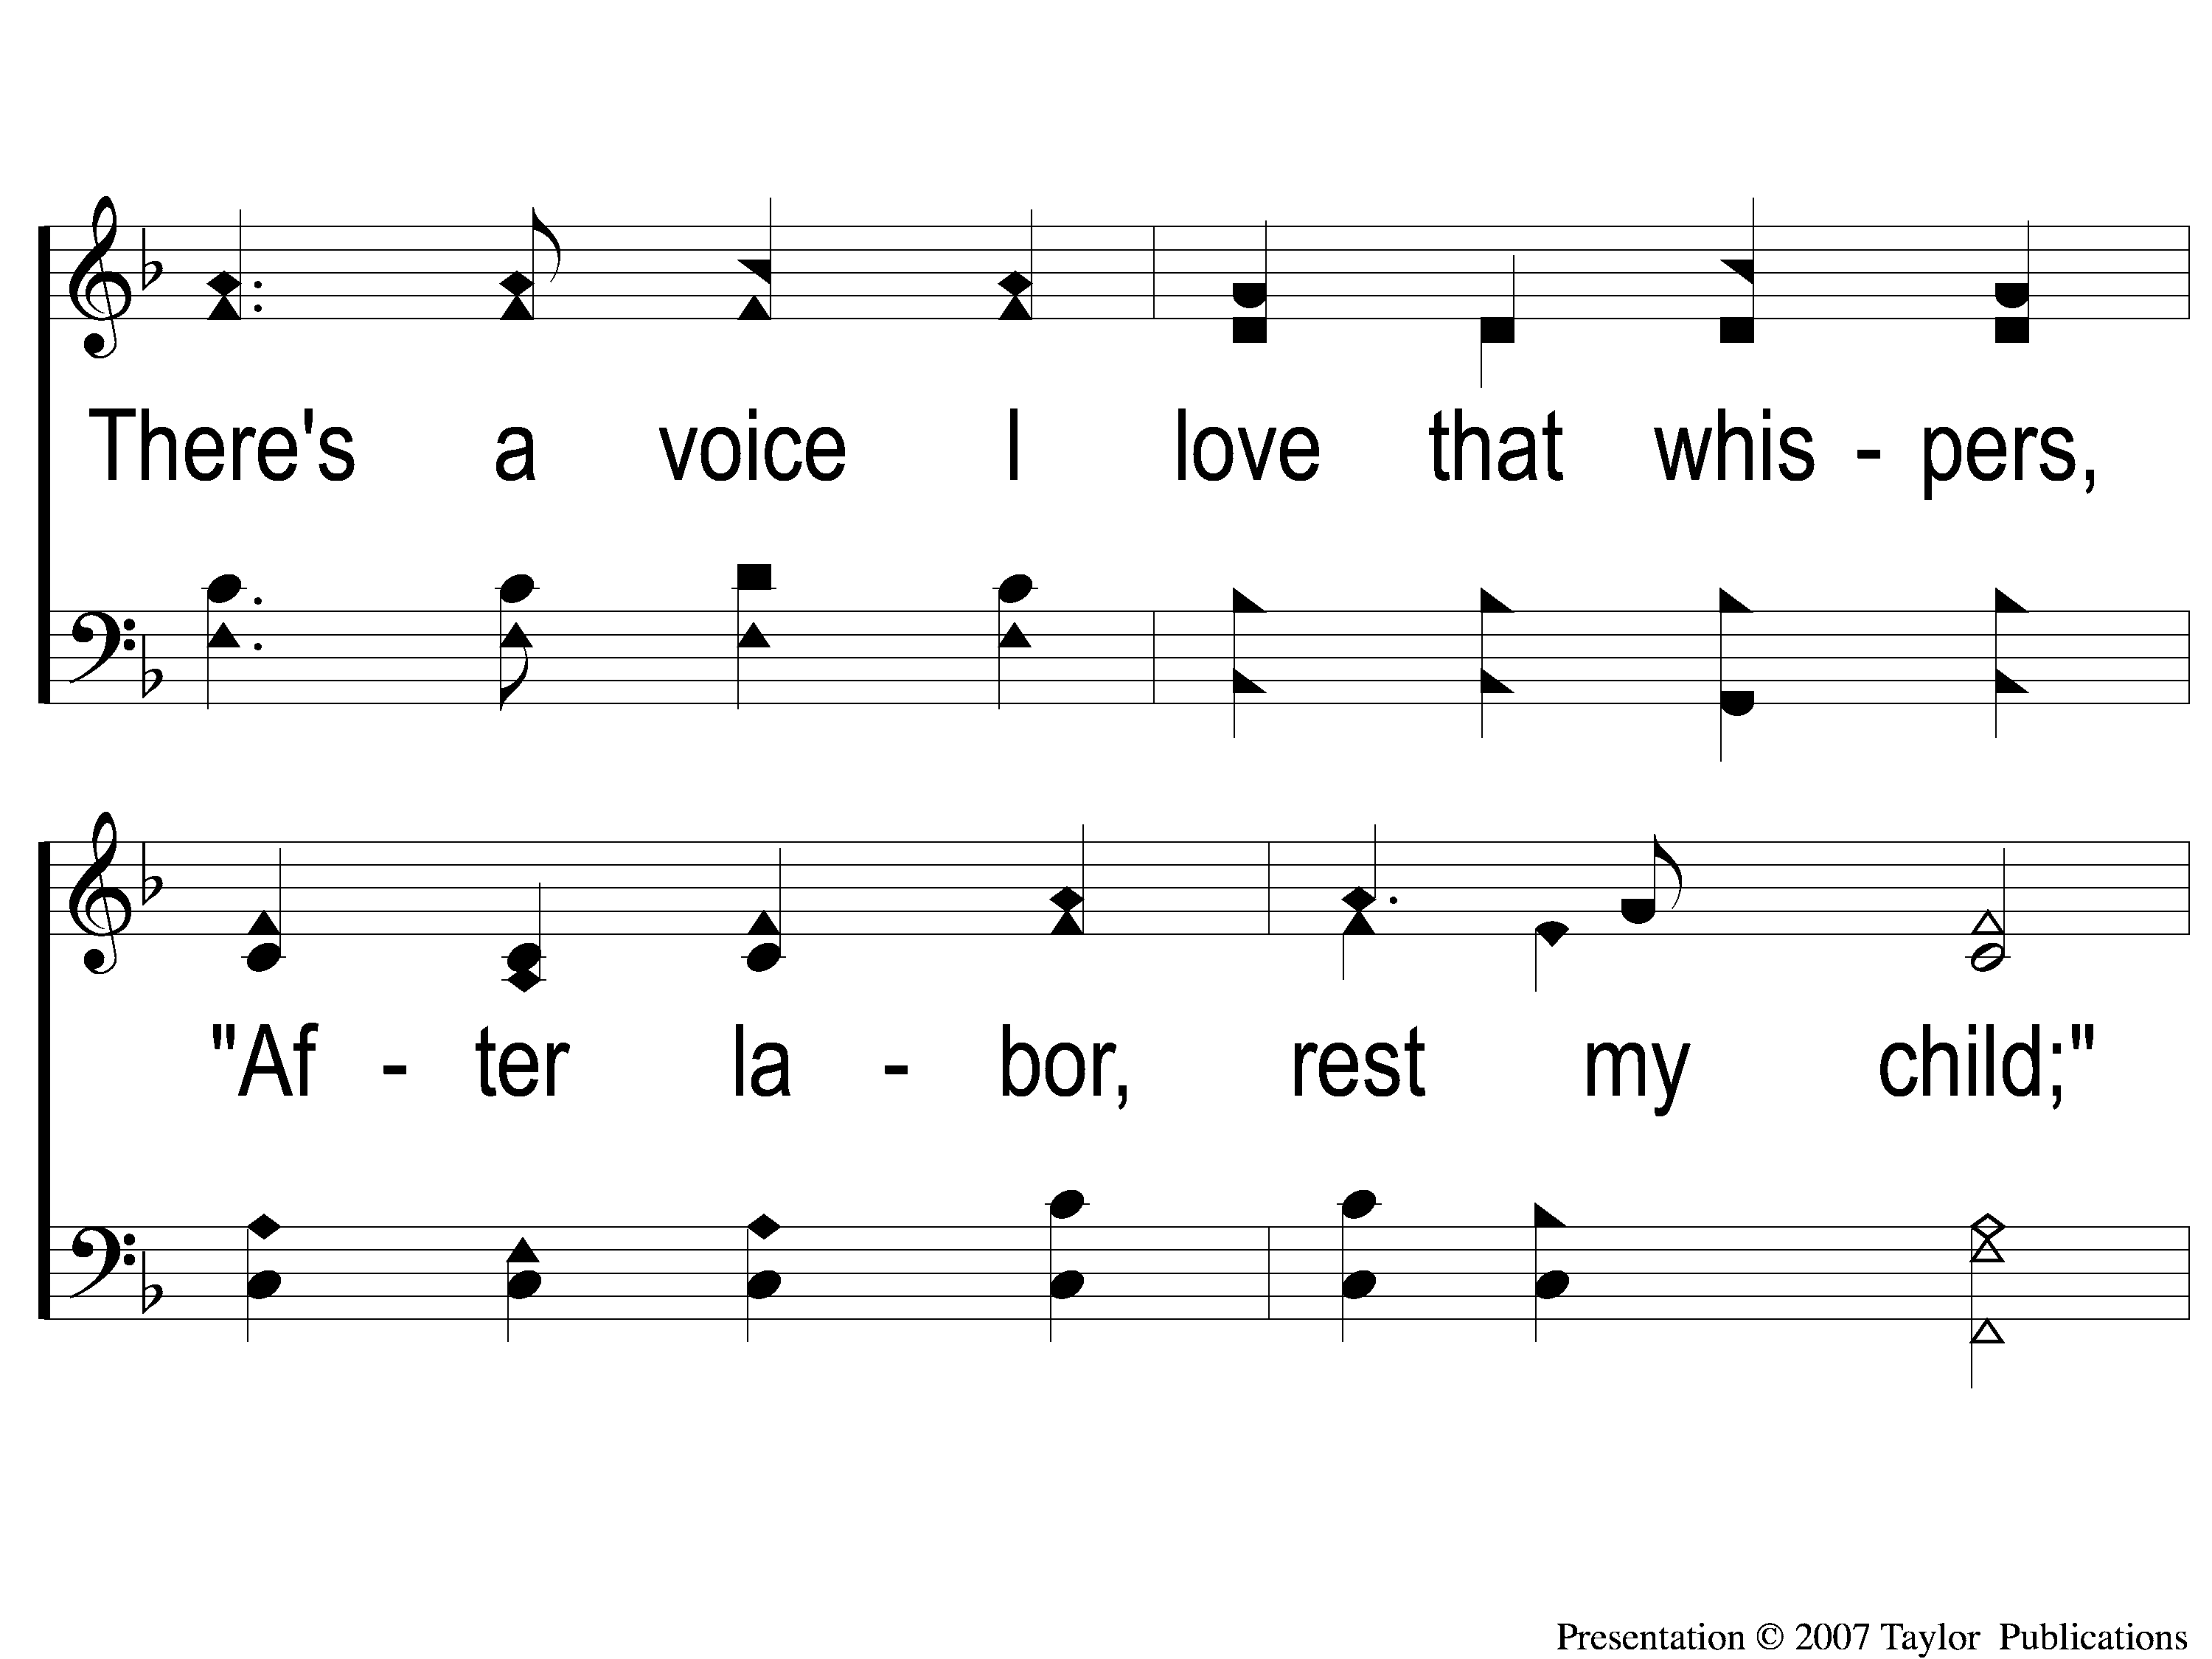
3-2 In the Hush of Early Morning
In the Hush of Early Morning
153
ePraise Hymn Presentation © 2005 Taylor Publications

Slide 11
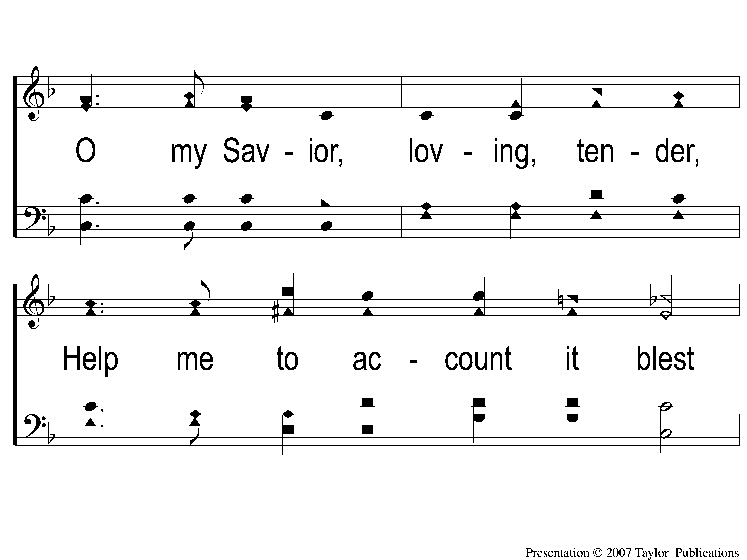
3-3 In the Hush of Early Morning
In the Hush of Early Morning
153
ePraise Hymn Presentation © 2005 Taylor Publications

Slide 12
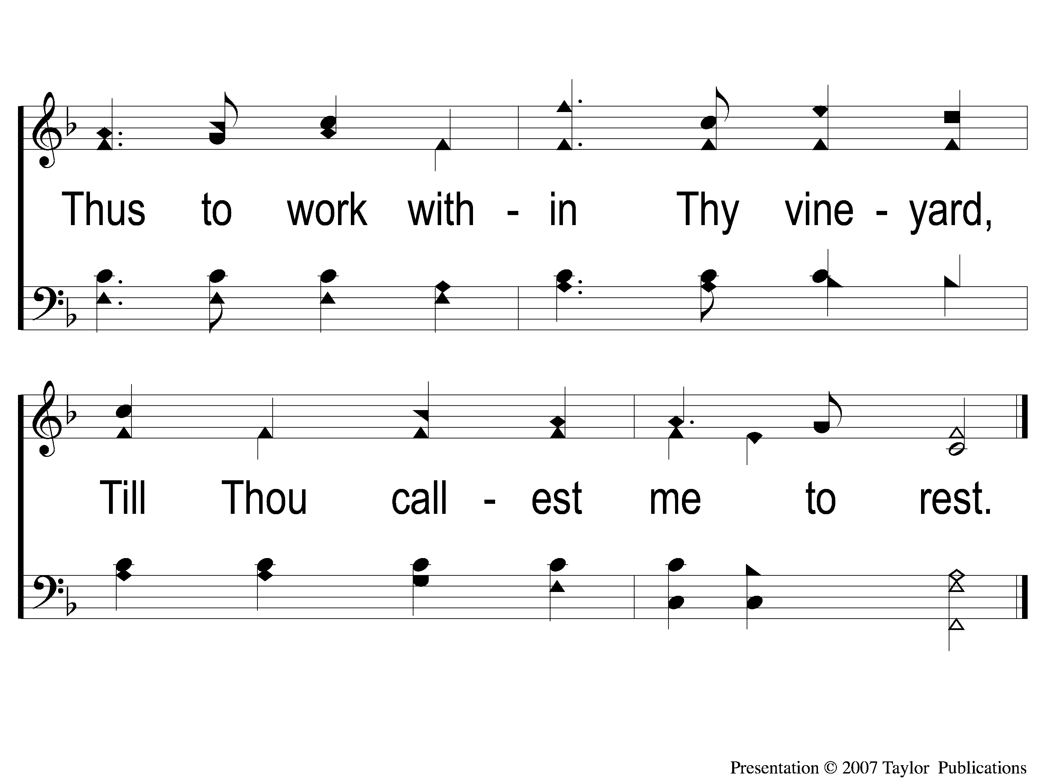
3-4 In the Hush of Early Morning
In the Hush of Early Morning
153
ePraise Hymn Presentation © 2005 Taylor Publications

